Slide 1



FRAUDULENT TRANSACTION MONITORING
Innoversite-2025

Slide 2


SaiGanesh
Dhinakar
Sreelalitha
Mehataj
Rushismita PAL
Venkata Adithya
tEAM N0 :02
Vinod Krishnan
Revathi R
Raj Kumar M
mentor:

Slide 3



Objective:
To develop a machine learning model that can identify suspicious transactions based on historical transaction data and customer behavior patterns. The solution should be scalable, efficient, and capable of integrating with existing banking systems to provide insights and enable timely action to mitigate risks.

Slide 4






PROBLEM STATEMENT
The existing methods for AML detection may not be sufficient to keep up with the evolving tactics of fraudsters, leading to potential vulnerabilities and increased risks for financial institutions and their customers. The challenge is to develop an innovative and efficient system that can detect suspicious transactions that can be potential money laundering activities, with the goal of preventing financial losses and protecting customers.

Slide 5



INTRODUCTION:
The integrity of financial institutions is seriously threatened by money laundering, which calls for efficient monitoring and detection systems. By examining transaction data and consumer behavior, this research seeks to create a system that can recognize possible money laundering operations and detect questionable transactions. To identify odd trends, such large or frequent transactions and strange account activity, the system makes use of sophisticated machine learning techniques. In order to reduce false positives and provide prompt alerts to financial institutions, it places a strong priority on accuracy. Through a smooth integration with current banking systems, the solution promotes regulatory compliance, improves security, and aids in the prevention of illegal financial activity.

Slide 6


METHODOLOGY
Testing samples
Data Pre-Processing
sampling
machine Learning models instances
Trained Model
Analysis and comparison of results obtained
Dataset
Training samples

Slide 7
MODEL AND APPROACH:
Algorithm:
Random Forest Classifier
One effective and popular machine learning approach for identifying fraudulent transactions is the Random Forest Classifier. Its capacity to handle big datasets, control unbalanced data, and identify intricate patterns in transactional behaviour makes it especially useful in this field. This is a thorough rundown of its application in transaction fraud detection.
Why Random Forest for Fraud Detection?
• Handles Imbalanced Data
• Robustness
• Feature Importance
• Scalability

Slide 8
Steps:
Data Set
Data Preprocessing
Sampling
Testing sample
Training sample
Machine learning model instances
Trained model
Analysis and comparison of results obtained

Slide 9
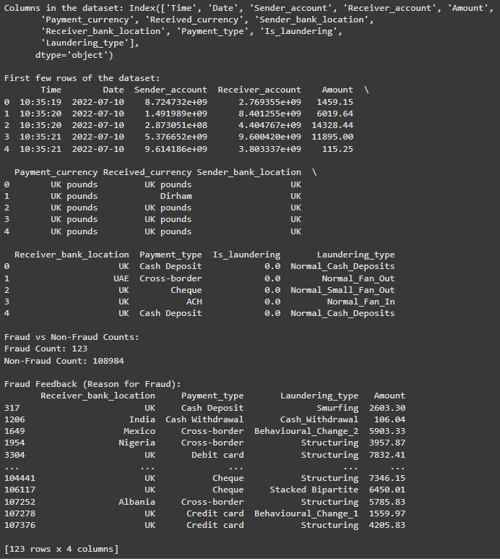
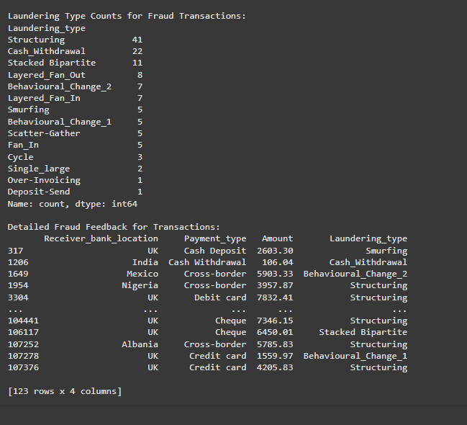
Result:

Slide 10
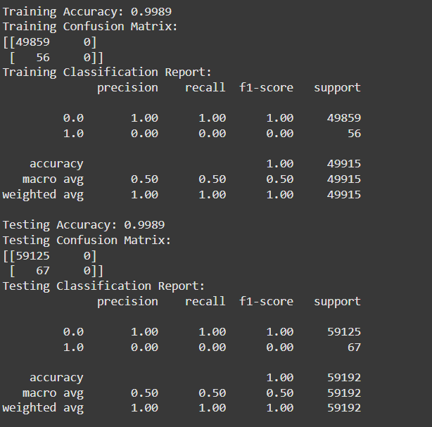
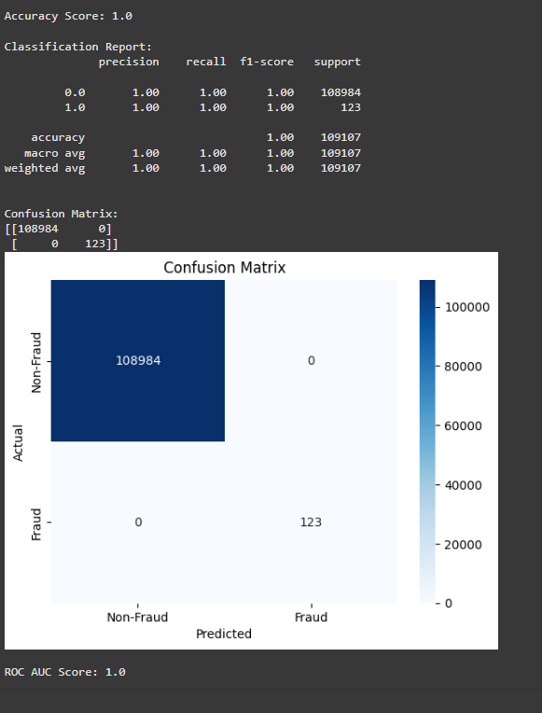
Result:

Slide 11




Conclusion:
The implemented fraud detection system using a Random Forest model achieved an exceptional 99.8% accuracy, effectively identifying fraudulent transactions with no false positives or negatives. Its scalability, seamless integration, and real-time alerting capabilities make it a robust solution, ensuring enhanced security while maintaining a seamless customer experience for financial institutions.

